Slide 1
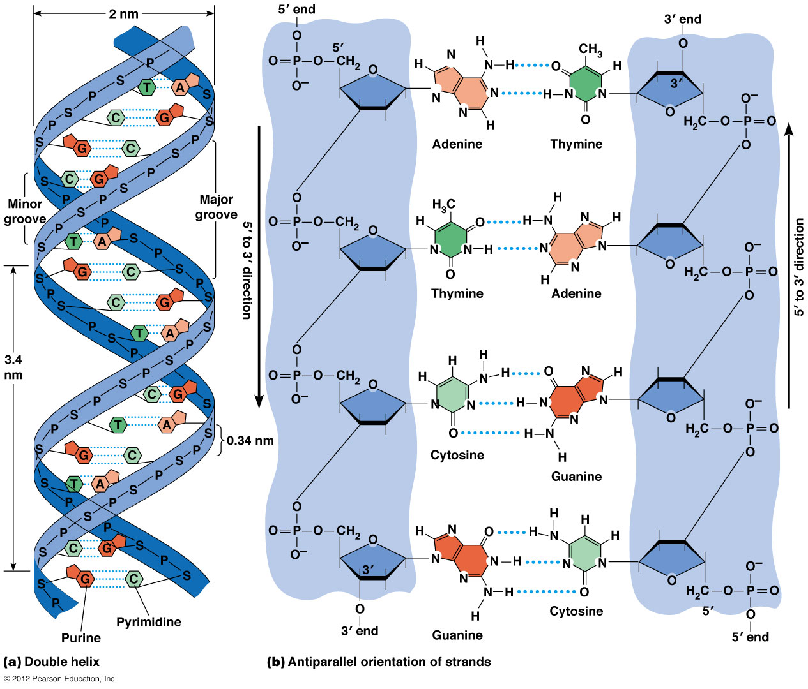
DNA Replication
Lecture - 8
10.5 bp/turn

Slide 2
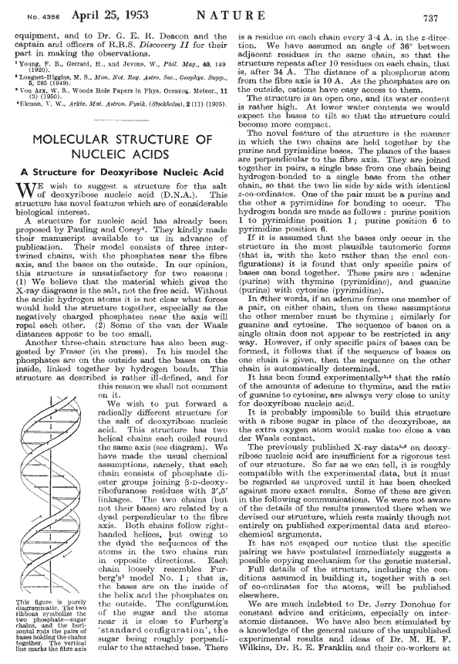
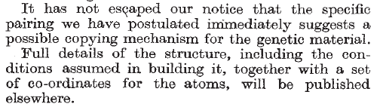

Slide 3
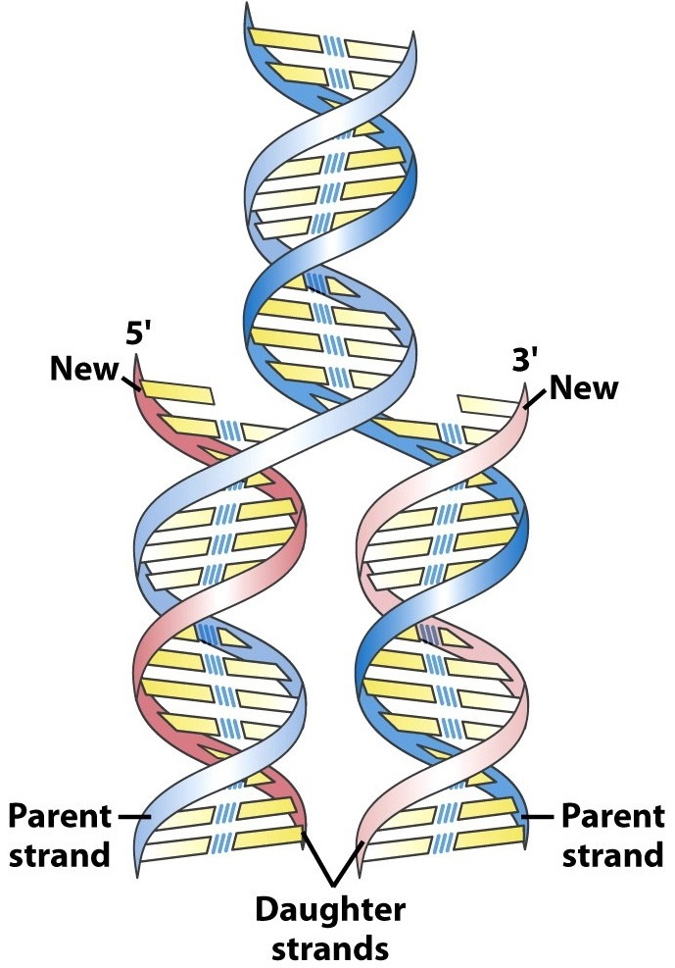
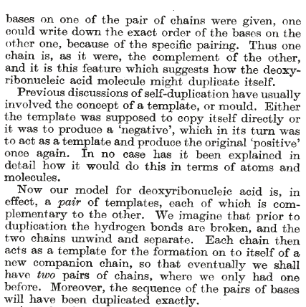
Watson & Crick hypothesis

Slide 5
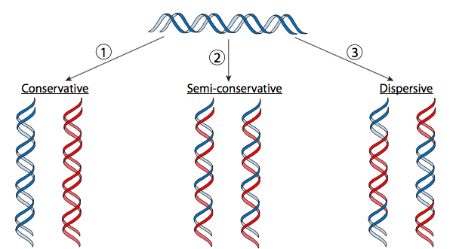
Possible modes of DNA replication
Notes:
In the semi-conservative model, the two parental strands separate and each makes a copy of itself. After one round of replication, the two daughter molecules each comprises one old and one new strand. Note that after two rounds, two of the DNA molecules consist only of new material, while the other two contain one old and one new strand.
In the conservative model, the parental molecule directs synthesis of an entirely new double-stranded molecule, such that after one round of replication, one molecule is conserved as two old strands. This is repeated in the second round.
In the dispersive model, material in the two parental strands is distributed more or less randomly between two daughter molecules. In the model shown here, old material is distributed symmetrically between the two daughters molecules. Other distributions are possible.
The Nobel Prize in Physiology or Medicine 1969 was awarded jointly to Max Delbrück, Alfred D. Hershey and Salvador E. Luria "for their discoveries concerning the replication mechanism and the genetic structure of viruses."

Slide 6
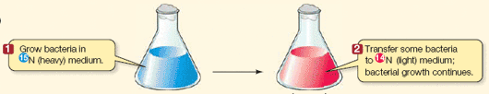
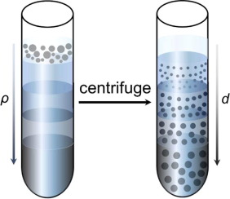
PNAS July 15, 1958
DNA replication is semi-conservative
Notes:
Density gradient centrifugation is based on the principle that molecules settle down under a centrifugal force until they reach a medium with the density the same as theirs.

Slide 8
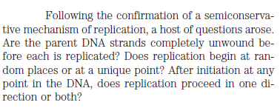
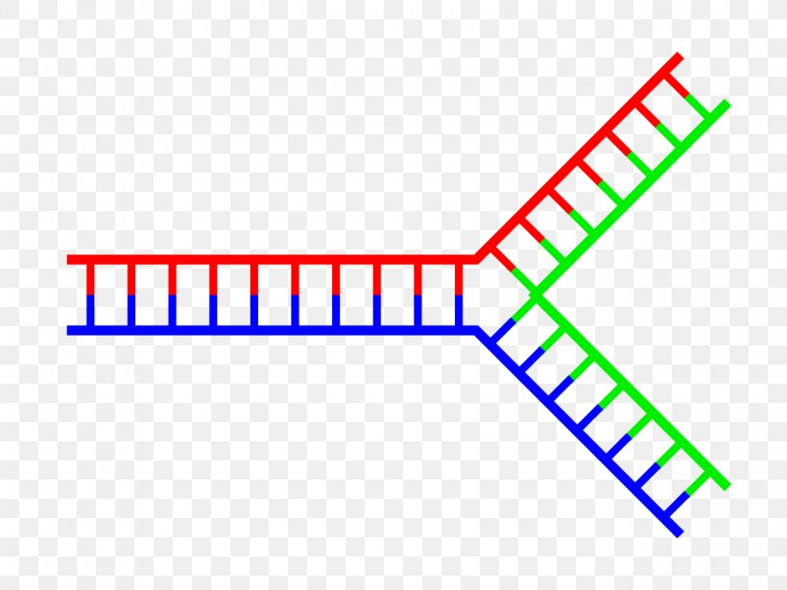

Slide 9
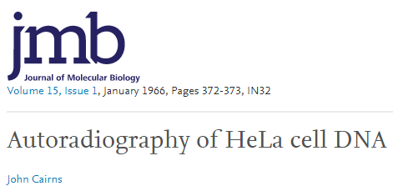
Identification of the Replication Fork
Notes:
In black-and-white photographic film, there is usually one layer of silver halide crystals. When the exposed silver halide grains are developed, the silver halide crystals are converted to metallic silver, which blocks light and appears as the black part of the film negative.

Slide 10
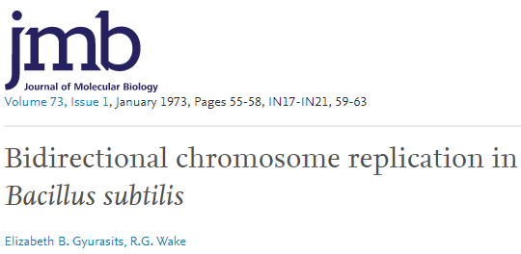
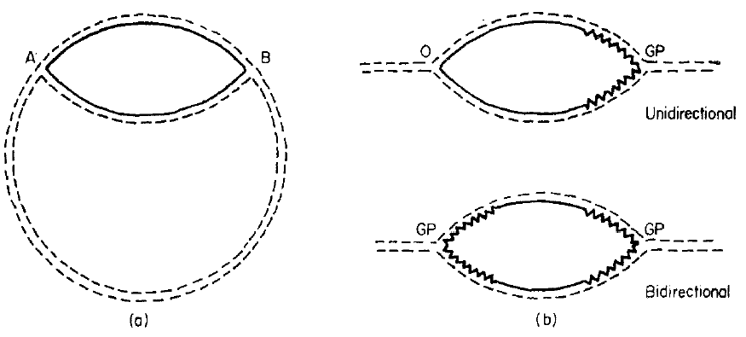
DNA replication is bidirectional
In 1973, Elizabeth B. Gyurasits and R. Gerry Wake devised a labeling protocol to distinguish between unidirectional and bidirectional replication. They first added [ 3H]thymidine with a relatively low specific activity to germinating Bacillus subtitlis spores to allow the replication bubble to become lightly labeled. Then the cells were diluted into a medium that contained [ 3H]thymidine with a much higher specific activity and the mixture was incubated for a short time. Unidirectional replication predicts a lightly labeled bubble with a short heavily labeled segment at one end, whereas bidirectional replication predicts a lightly labeled bubble with heavily labeled segments at both ends, the evidence to support bidirectional θ-replication support bidirectional bacterial DNA replication.

